Slide 1


Subsurface Energy Data Science
Spatially Adaptive Learning for Multi-Resolution Model Updating
Mahammad Valiyev (PhD Student)
February 8, 2023
USC Campus, Los Angeles - California
Energi Simulation Industrial Research Chair Program Annual Meeting - 2023
Notes:
Hi everyone, my name is MV, I will talk about my project, which is about …

Slide 2
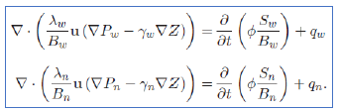
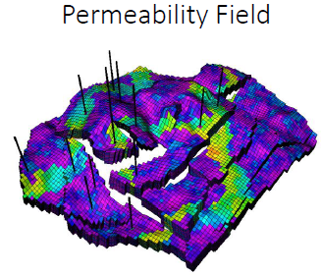
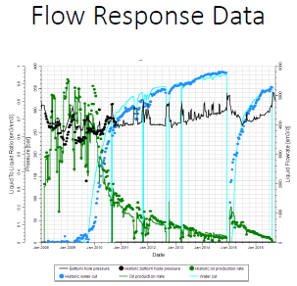
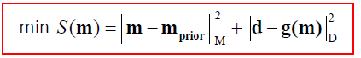
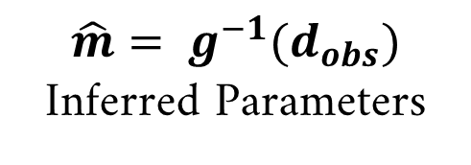
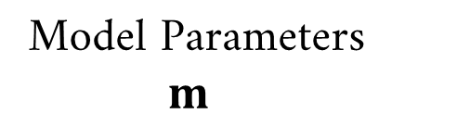
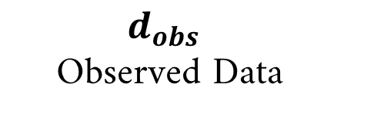
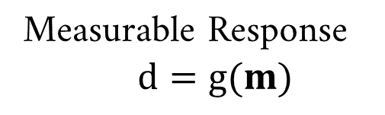
Introduction: Forward and Inverse problems
History Matching (Inverse Problem) is a default workflow for building a confidence in Reservoir Simulation (Forward Problem) models
Forward Problem
Model Parameters
$m$
Measurable Response
$d=g(m)$
$$\hat{m}= g^{−1}(d_{obs})$$
Inferred Parameters
$d_{obs}$
Observed Data
Inverse Problem
Notes:
- In subsurface systems, we have forward and inverse problems
By forward problem, we usually mean, going from properties such as k, por to flow obs: P, Q by solving fluid flow equations
Whereas inverse problem represents the opposite problem of going from observations to the parameters
In oil and gas systems, we usually solve inverse problem, called History matching workflow to build a confidence in our forward models

Slide 3
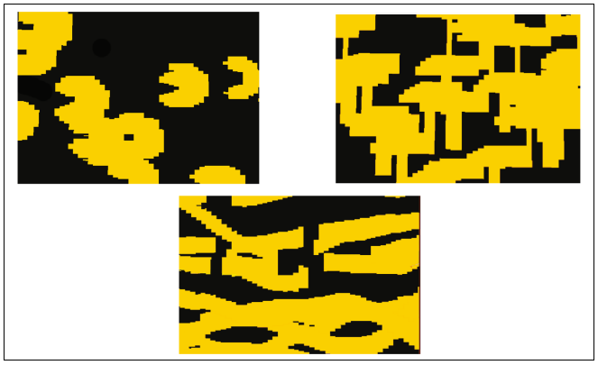
Introduction: Inverse problem challenges
Uncertainty
Subsurface description (Geologic uncertainty)
Measurement noise
Modeling errors
Computational complexity
Complex nonlinear forward model
High dimensionality of models
Parameter & data resolution mismatch
High-dimensional model parameters
Limited data resolution
Implications
Non-uniqueness & loss of geological realism
(Demyanov et al., 2018)
Notes:
Solving inverse problems is challenging
First and foremost problem is uncertainty; we deal with a lot of uncertainty in subsurface systems at multiple levels, such as… 1)
Then there is an issue of computational complexity, solution of inverse problems require forward simulations (reservoir simulation, many times) and each run is usually expensive, since 1) and 2)
And last but not least, we have a mismatch between the resolution of parameters and data
Implications: 1) mismatch in m and d leads to non-uniqueness: more than 1 model can match the observations 2) loss of geological realism: as we update the parameters independently without imposing some geological constraint
In our problem, we address this issue

Slide 4
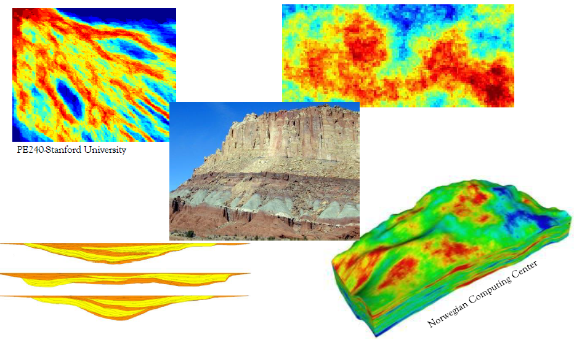
Motivation
Geological formations are continuous, resulting in spatially correlated properties
This property enables more efficient (low-dimensional) representation
Notes:
If we look at geological formations, we can see continuity, same rocks extend for large distances – spatial correlation in properties
We can take advantage of this property, to improve our modeling approach

Slide 5
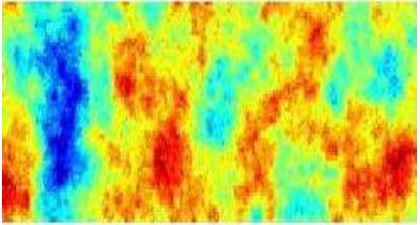
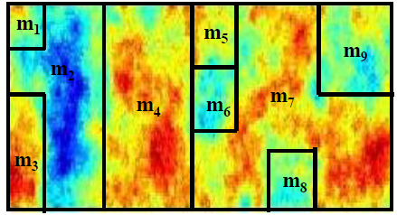
Literature review: Traditional methods
Spatial methods
Challenges & Issues:
1) identification of regions 2) sharp discontinuities
Notes:
Up to now, largely 2 type of solutions have been offered:
Separate high resolution models into some zones with similar properties, and assign average value – upscaling, can be in 2 ways
Issue is that 1) identification is arbitrary and manual (boundaries and number of zones) 2) sharp boundaries – non-geological
Transform methods: map the original model space to alternative more efficient coordinate basis and then use some fraction of coordinate vectors
Complex models – we still high number of coordinate vectors and for some methods, bases are general, prior info is hard to incorporate
So, find alternative method for low-dimensional representation of models

Slide 6
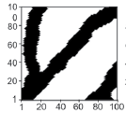
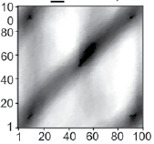
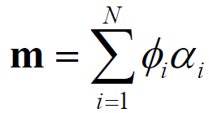
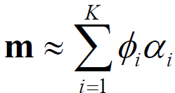
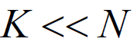
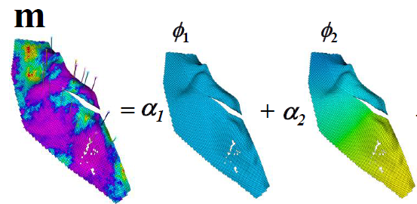
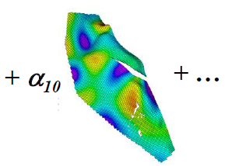
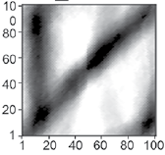
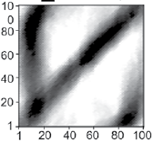
Literature review: Traditional methods
Transform methods
Original
PCA, k=4
PCA, k=8
PCA, k=16
Jiang, Jafarpour*(2021), Advances in Water Resources.
Challenges & Issues:
1) reconstruction of complex geomodels 2) incorporation of prior information
Notes:
Up to now, largely 2 type of solutions have been offered:
Separate high resolution models into some zones with similar properties, and assign average value – upscaling, can be in 2 ways
Issue is that 1) identification is arbitrary and manual (boundaries and number of zones) 2) sharp boundaries – non-geological
Transform methods: map the original model space to alternative more efficient coordinate basis and then use some fraction of coordinate vectors
Complex models – we still high number of coordinate vectors and for some methods, bases are general, prior info is hard to incorporate
So, find alternative method for low-dimensional representation of models

Slide 7
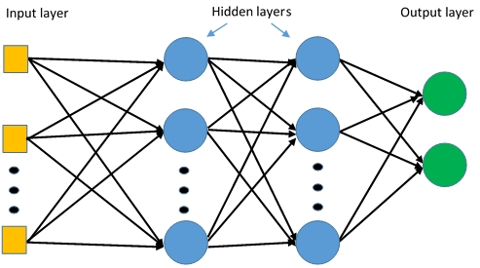
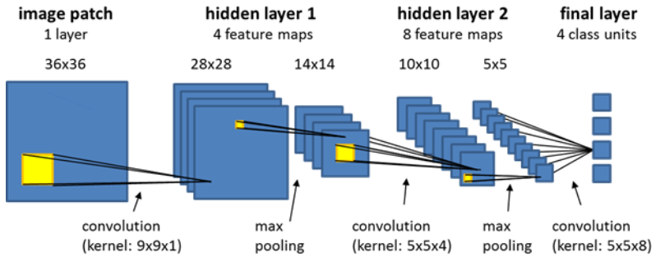
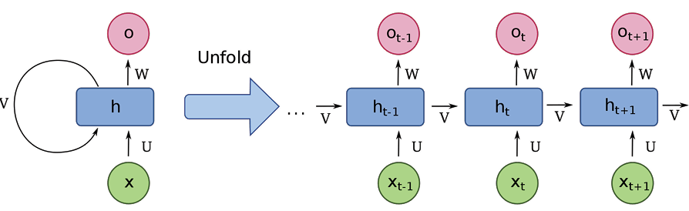
Deep Learning
Multilayer perceptron (for tabular data), DeepAI.org
Convolutional neural network (for spatial data), ecognition.com
Capabilities:
Ability to learn very complex non-linear functions
Can be applied to various type of problems and data (tabular, images, timeseries)
Recurrent Neural Networks (for timeseries data),
techtarget.com
Notes:
- Recently, DL became very successful in industrial and scientific applications
Main advantages are 1) … 2) …
Different architectures exist to solve those problems

Slide 8
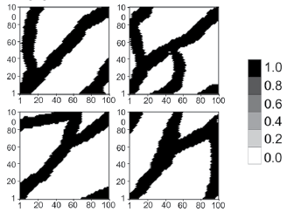
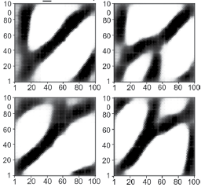
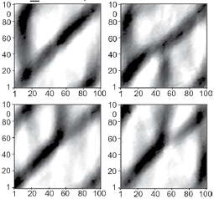
Literature review: Deep Learning for parameterization
Autoencoder
Deep learning architectures offer better reconstruction capability than traditional methods
Original model realizations
Generated using VAE
Generated using PCA
Jiang, Jafarpour*(2021), Advances in Water Resources.
Notes:
DL was also applied to subsurface system, for low-dimensional representation of geological models
Some variants of DL architectures, VAE and GANs have been successfully applied and tested on inverse problems and show better performance compared to PCA

Slide 9
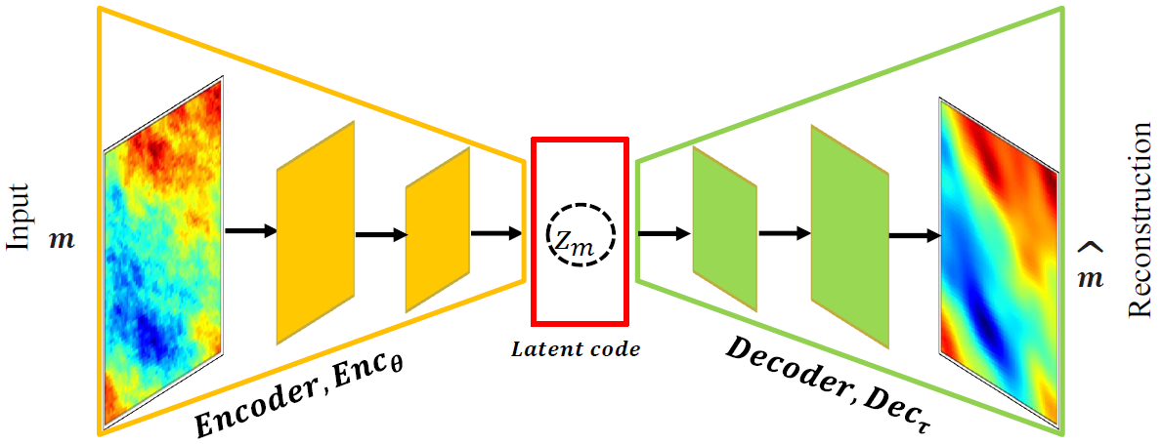
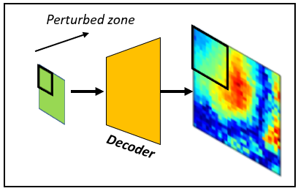
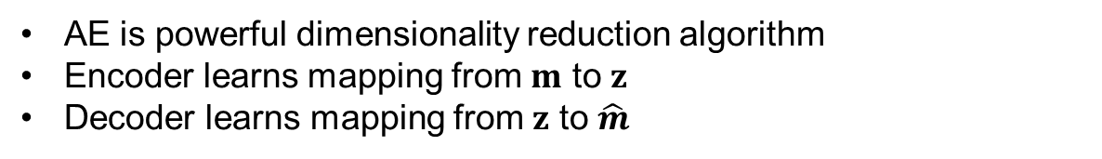
Autoencoder architecture
AE is powerful dimensionality reduction algorithm
Encoder learns mapping from $m$ to $z$
Decoder learns mapping from $z$ to $\hat{m}$
Latent space in AE is not interpretable
Understanding Latent space of DL models is an active research area
Notes:
DL was also applied to subsurface system, for low-dimensional representation of geological models
Some variants of DL architectures, VAE and GANs have been successfully applied and tested on inverse problems and show better performance compared to PCA

Slide 10
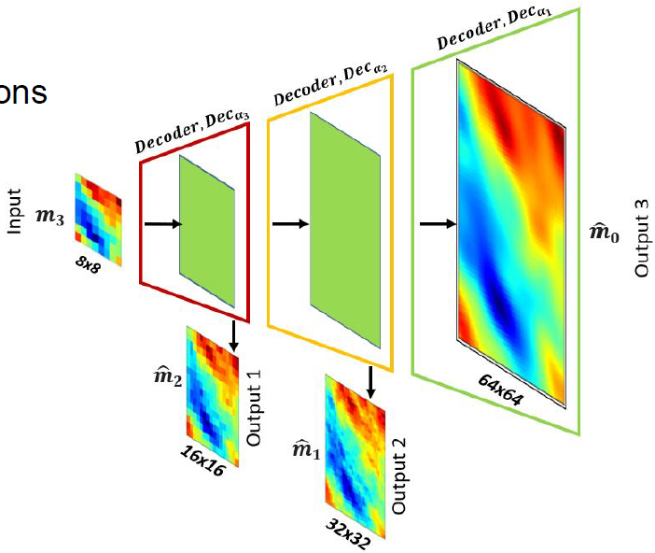
Multiresolution neural network architecture
Autoencoder architecture
Multiresolution architecture
2 modifications to standard AE:
Replace encoder with upscaling function
Constrain intermediate outputs with loss functions
Changes enable:
Spatially interpretable latent spaces
Multiresolution output capability
Notes:
In our approach, we start with an autoencoder, is standard DL architecture for dimensionality reduction and make 2 changes
1) replace encoder with upscaling function – so, that our input is interpretable low-dimensional model and 2) constrain the intermediate latent outputs with loss functions to have interpretable outputs and spatial interpretability

Slide 11
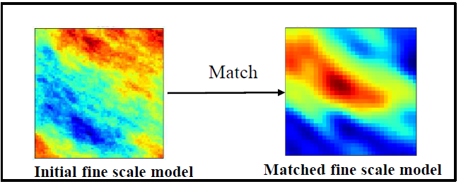
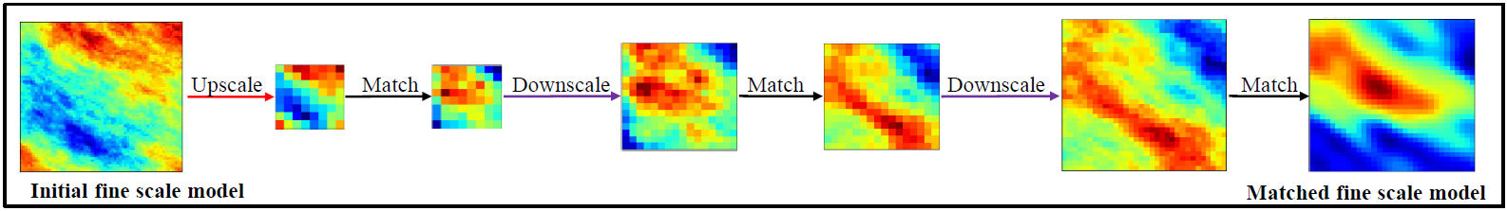
Multiresolution model calibration workflow
Multiresolution model calibration workflow with spatially adaptive update capability brings
1) efficiency and 2) flexibility

Slide 12
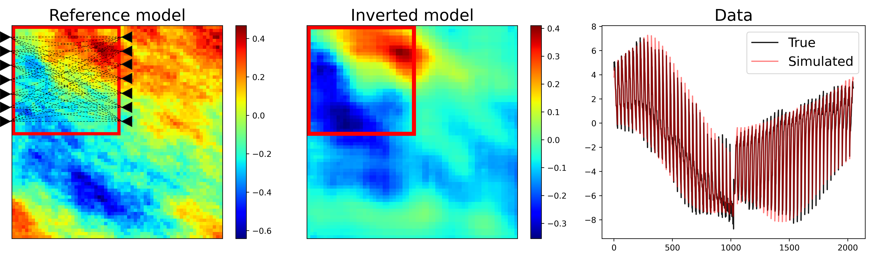
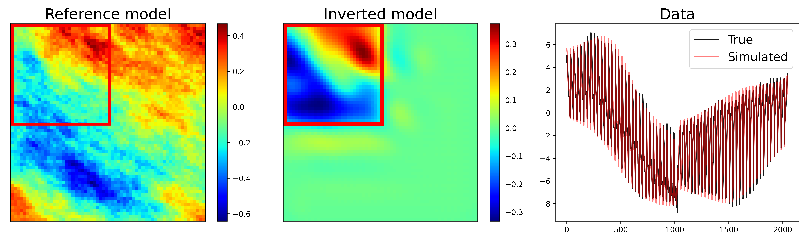
Results 1: Local model calibration
Autoencoder architecture
Multiresolution architecture
Notes:
In this example, we local model calibration, observations are from upper left quadrant, so our goal is modify only that section in the model
You can se the results of inversion using both architectures, both have a good data match and are in agreement with reference model
In AE, updates are outside of data sensitivity zone, in multiscale only limited zone, because we know what part of the model will be affected if we introduce a change

Slide 13
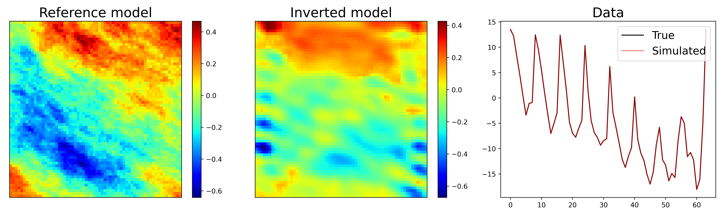
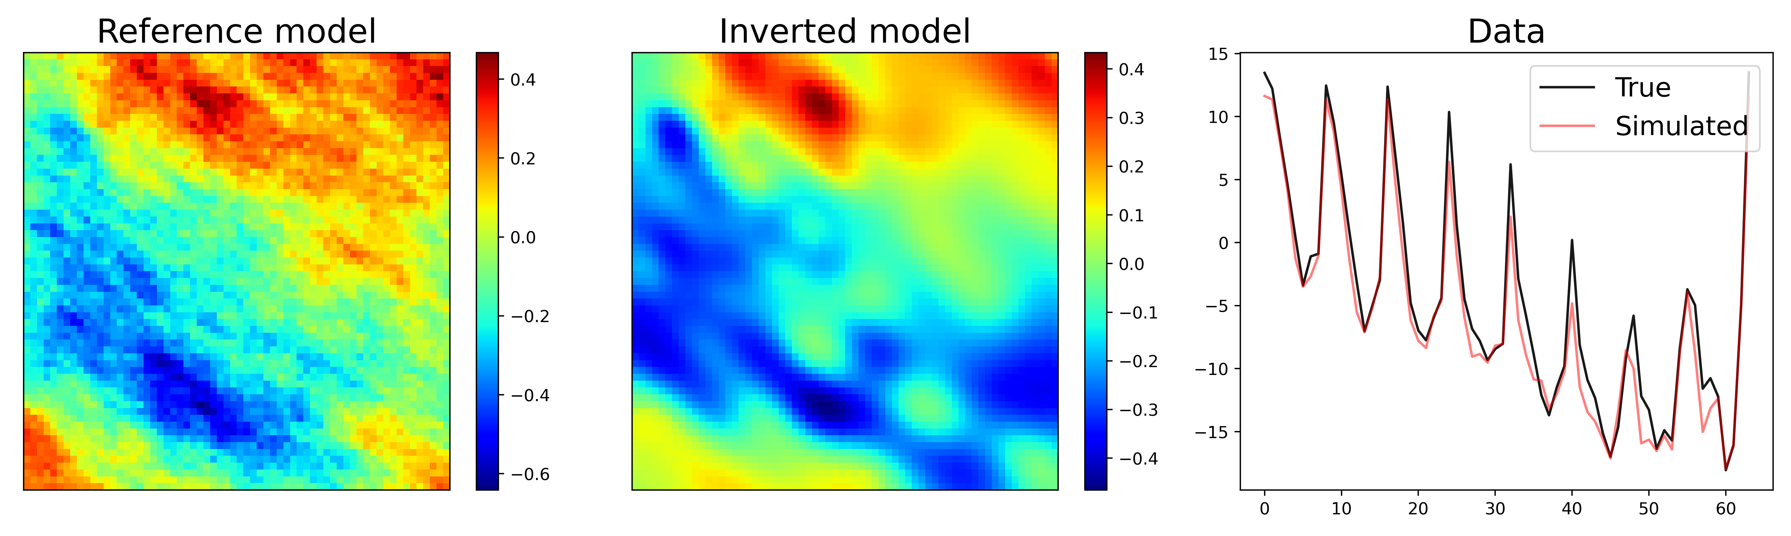
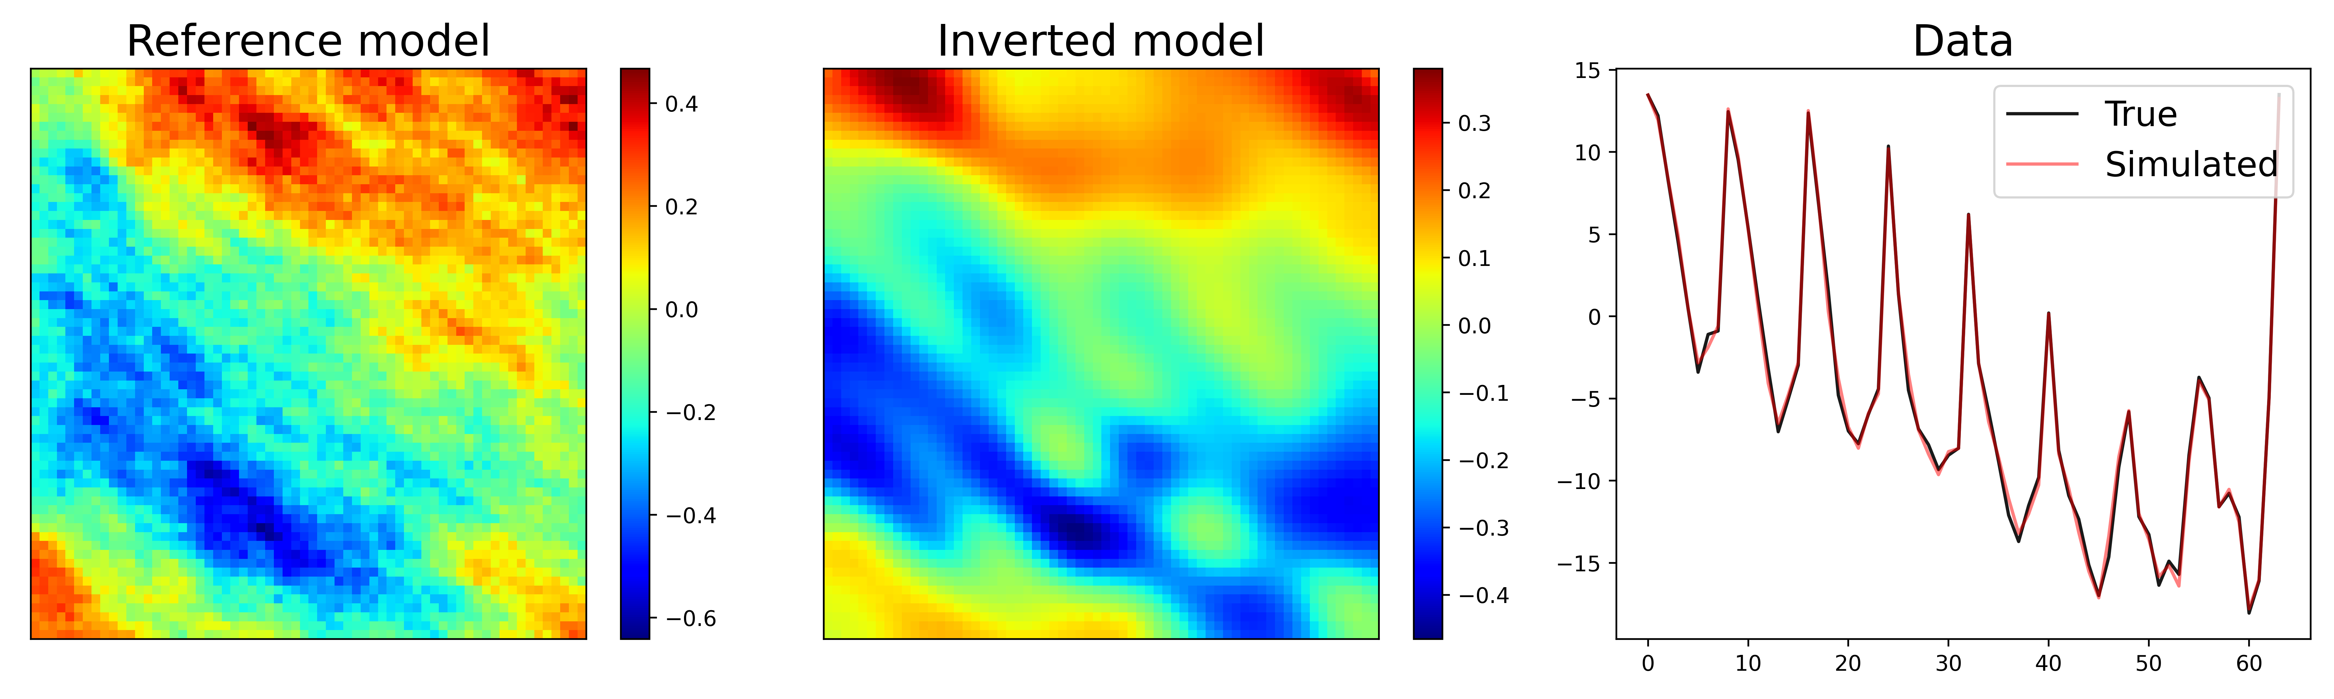
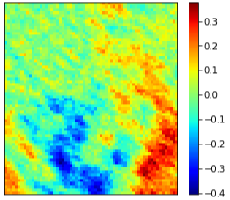
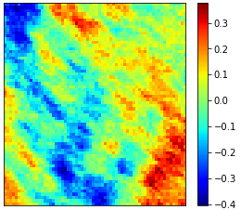





Results 2: Multiscale model calibration
Reference model, $m_{ref}$
Multiscale inversion, $m_{16x16}$
Multiscale inversion, $m_{8x8}$
Residual: $m_{ref}−m_{16x16}$
Residual: $m_{ref}−m_{8x8}$
Notes:
-In this example, we show advantage of doing model calibration at multiple scale, which is enable by our architectures
-We first do an inversion with global data, that cover the whole field and then we focus on upper left quadrant using local data
- We see that we can improve the model match by using local data, so our model enables multiresolution and local model updating – we can do several scales and focus on any zone

Slide 14
Conclusion and Further Work
In this work, standard Autoencoder architecture has been modified to enable spatial interpretability of latent spaces and multiresolution output capability
These two properties bring efficiency and flexibility to inverse modeling workflow
Additional experiments involving multiphase flow problems and more complex geologic settings, can provide additional insight into the properties of the proposed workflow

Slide 15


Acknowledgements

Slide 16
Subsurface Energy Data Science
Spatially Adaptive Learning for Multi-Resolution Model Updating
Mahammad Valiyev (PhD Student)
February 8, 2023
USC Campus, Los Angeles - California
Energi Simulation Industrial Research Chair Program Annual Meeting - 2023

